Slide 1

IST 718
Life Expectancy (WHO) Analysis
Final Presentation
26 March 2023
Nick McFadden
Soham Nanavati
Sahil Nanavaty
Phuong (Adrianne) Van
Cole Wood

Slide 2
Business Questions
What are the top factors of life expectancy? Any other major factors?
Does life expectancy have a positive or negative relationship with the various factors (eating habits, population, exercise, health, etc.)
Should a country having a lower life expectancy value (<65) increase its healthcare expenditure to improve its average lifespan?

Slide 3
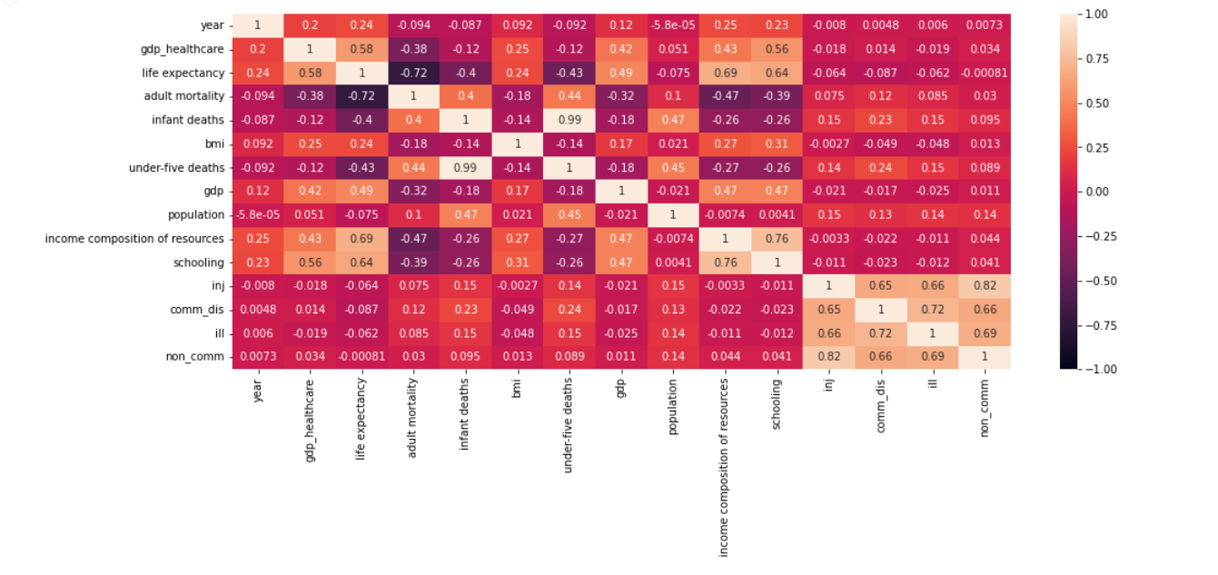
Observation
The following factors have the highest correlation to life expectancy: GDP Healthcare, Adult Mortality, Income Composition of Resources and Schooling

Slide 4
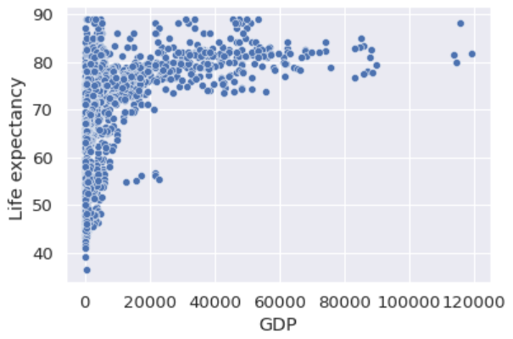
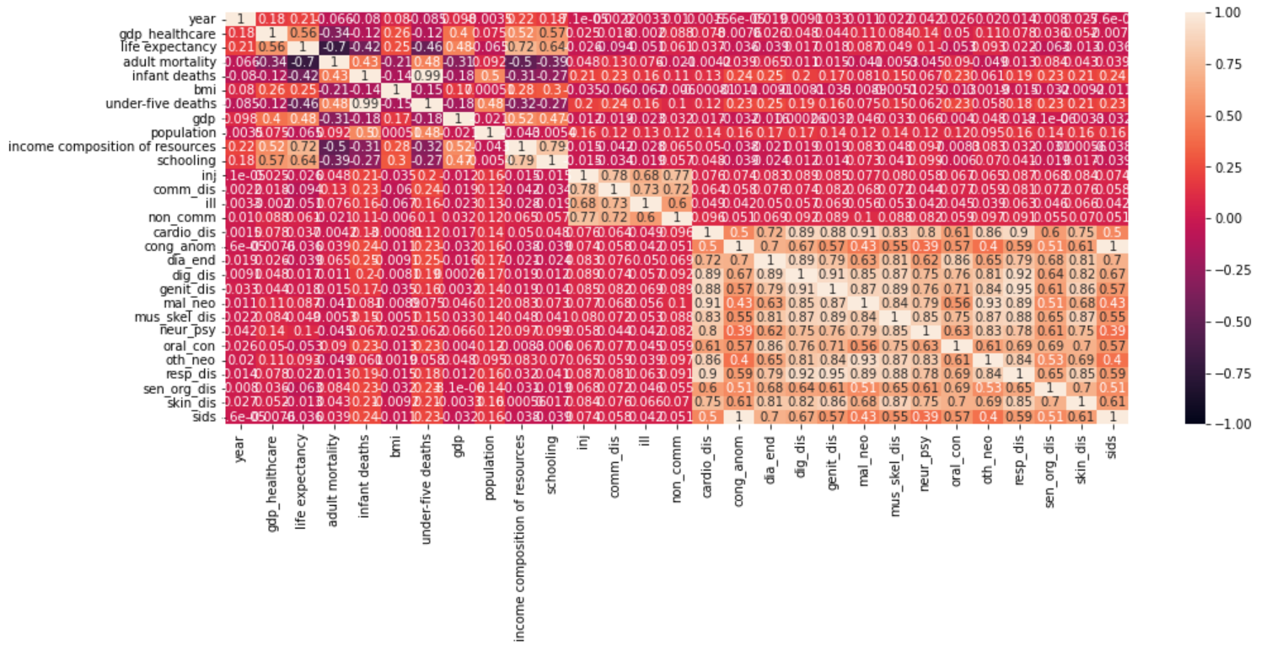
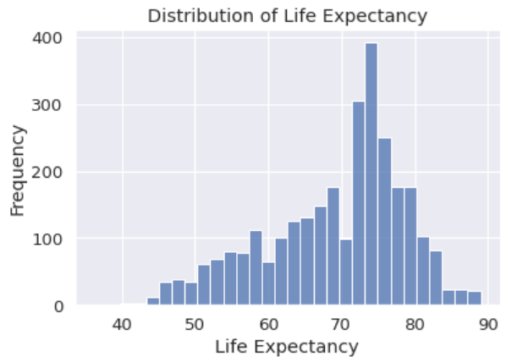
Observation - EDA
We merged 20 different datasets from Kaggle, WHO, and World Bank

Slide 5
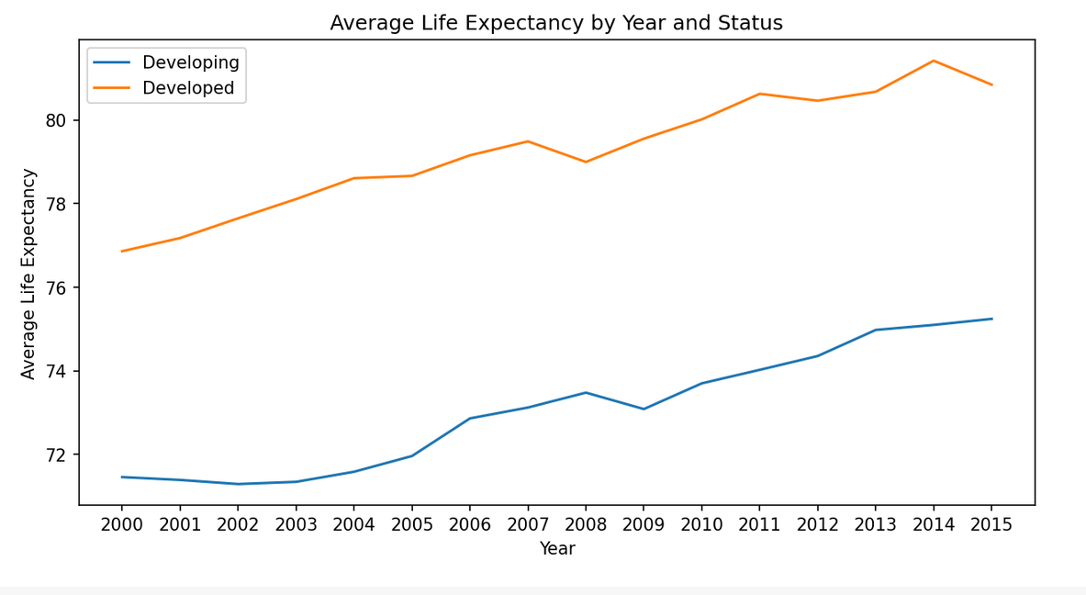
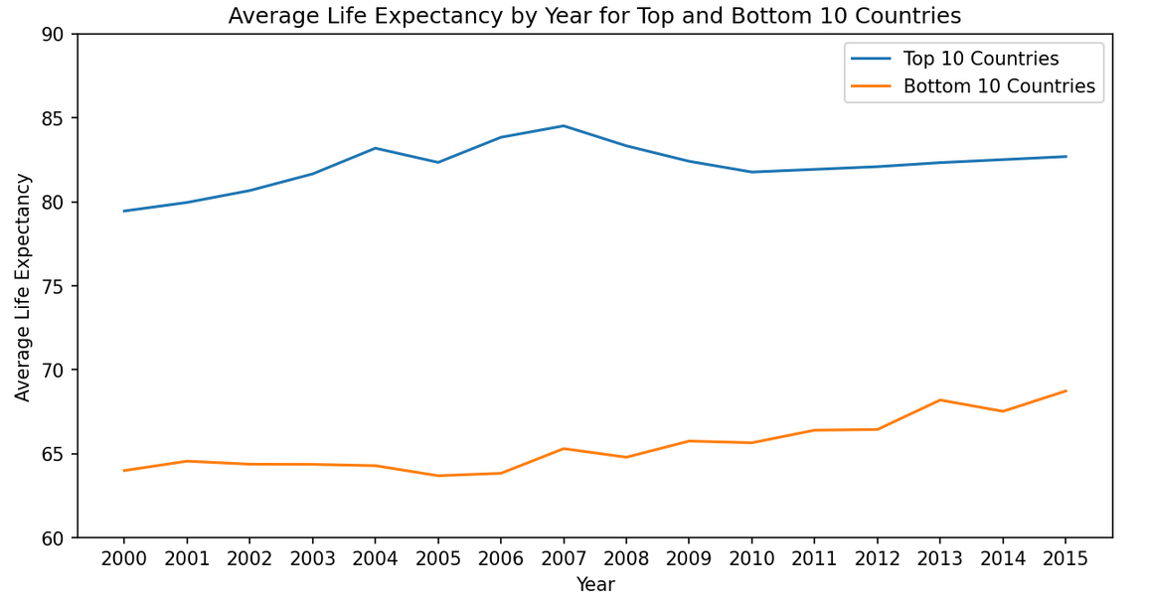
Observation
Significant gap between developed and developing countries; however, life expectancy has been improving for both developed and developing countries over time as observed from 2000 to 2015.

Slide 6
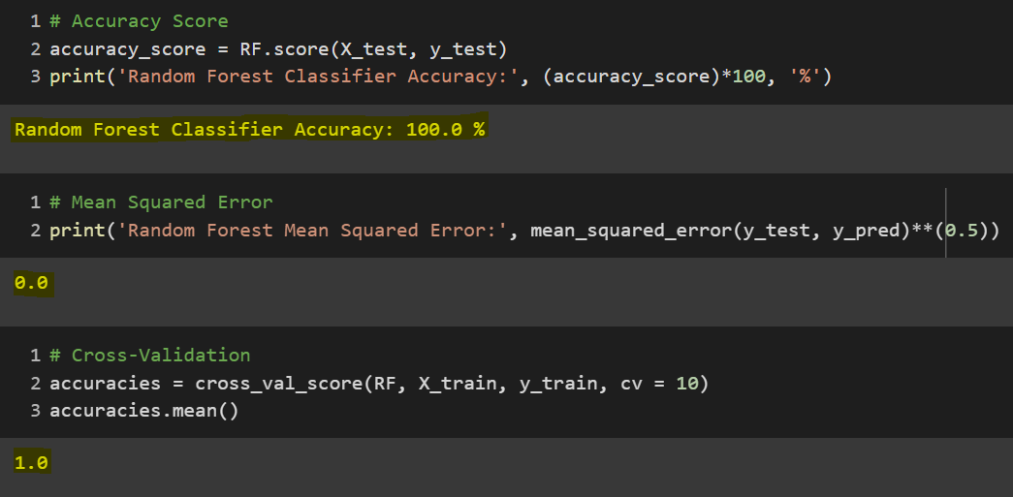
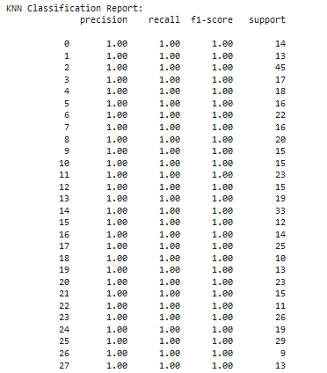
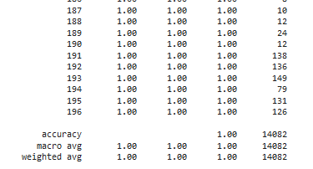
Trial & Error
The team initially proposed and developed classification models (Random Forest and K nearest neighbor). However, the team determined the classification models were not suitable for predicting life expectancy since they were classifying the results into various life expectancy values. The models erroneously showed 100% accuracy.
Random Forest
KNN

Slide 7
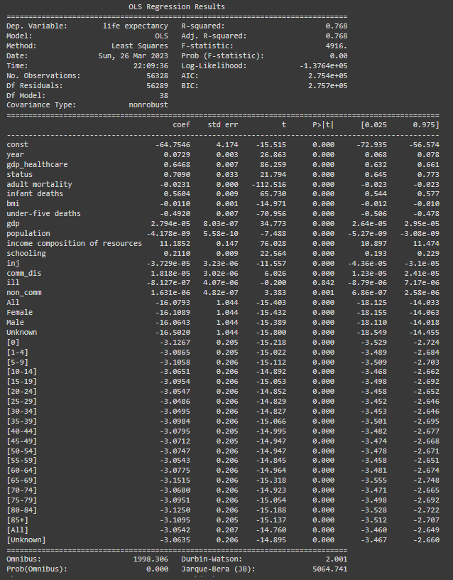
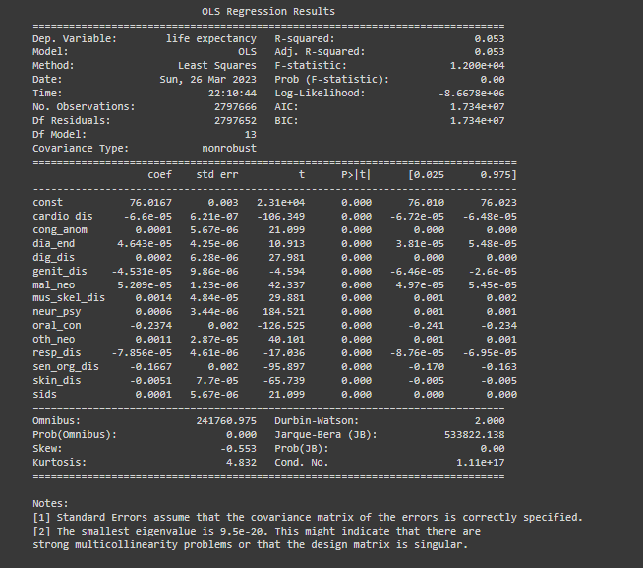
Linear Regression Model Performance

Slide 8
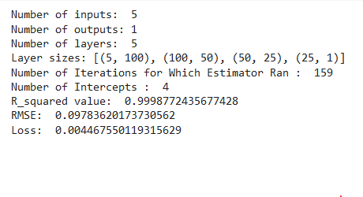
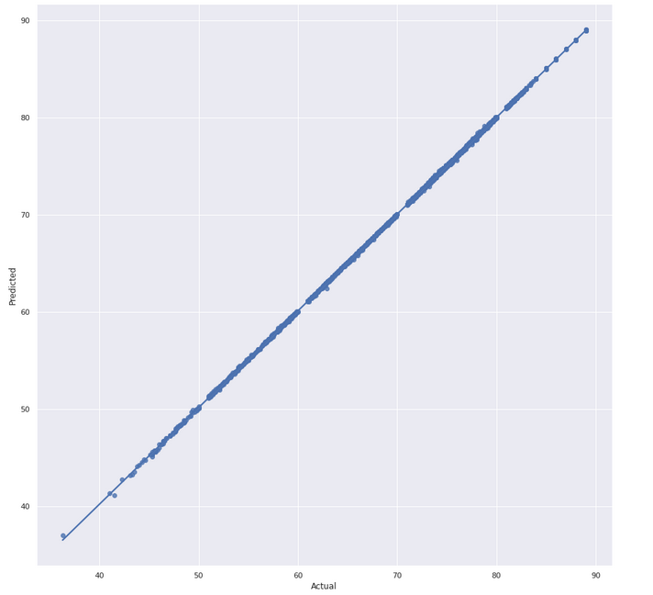
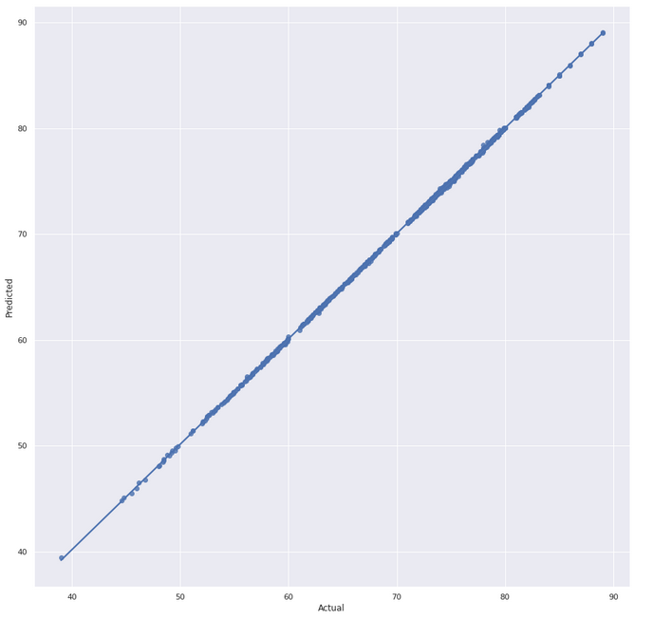
Neural Network Model Performance
Performed Multi-Layer Perceptron (MLP) Regressor
Predicted life expectancy based on GDP Healthcare, Adult Mortality,
Schooling and Income Composition of Resources
Training Data Results
Test Data Results

Slide 9
Analysis
GDP Healthcare, Adult Mortality, Income Composition of Resources and Schooling are the most influential factors on life expectancy based on significant correlation and low p-value per the linear regression model.
Both linear regression and neural network models overall had high prediction accuracy of life expectancy based on the determined factors listed above.
While the data suggests the above factors influence life expectancy, the data does not reflect other factors that impact life expectancy including: diet, income disparities, economic structure, corruption and any other social and economic factors.

Slide 10
Conclusion
What are the top factors of life expectancy? Any other major factors?
Does life expectancy have a positive or negative relationship with the various factors (eating habits, population, exercise, health, etc)
Adult Mortality - Negative
Income Composition of Resources - Positive
Schooling - Positive
GDP Healthcare – Positive
Other factors – shown on slide 5
Should a country having a lower life expectancy value(<65) increase its healthcare expenditure in order to improve its average lifespan?
We observed positive correlation between healthcare expenditure and life expectancy; however, we could not quantify the results to provide an accurate, relevant recommendation on how much it can improve life expectancy.

Slide 11

THANK YOU!

